Slide 1
Review
What did we learn last time?
Questions:
What will be provided for quizzes?
How do you do Midpoint?

Slide 2
Math 152 – Lesson 4
Lesson | Topic | Reading
3 | Approximate Integration | 7.7
4 | Antiderivatives | 4.9
5 | Fundamental Theorem of Calculus | 5.3
Objectives:
Calculate antiderivatives of a function as a family of functions
Calculate antiderivatives of functions given in first column of table on p 345
Use antiderivatives & initial conditions to calculate:
a) velocity from acceleration
b) position from velocity
Given F'(x), graph the antiderivative, F(x)
Given F'(x), identify the points of interest of F(x)

Slide 3
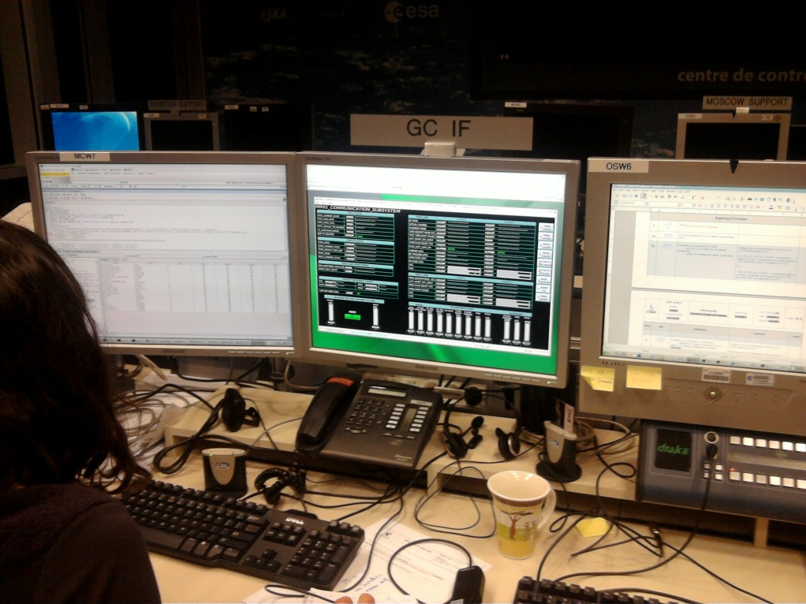
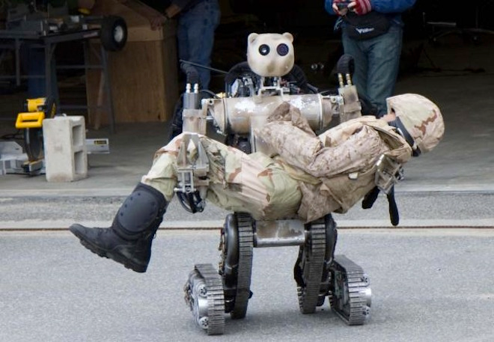
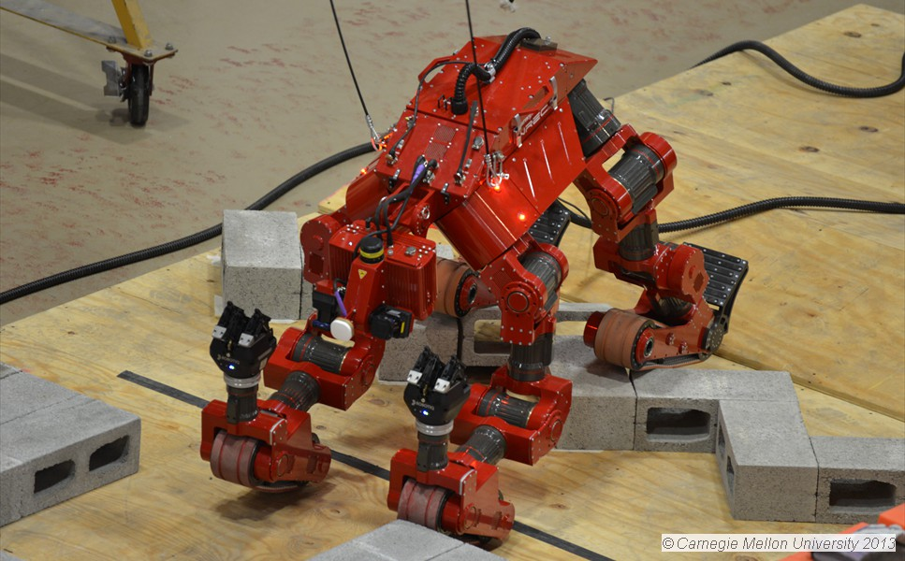
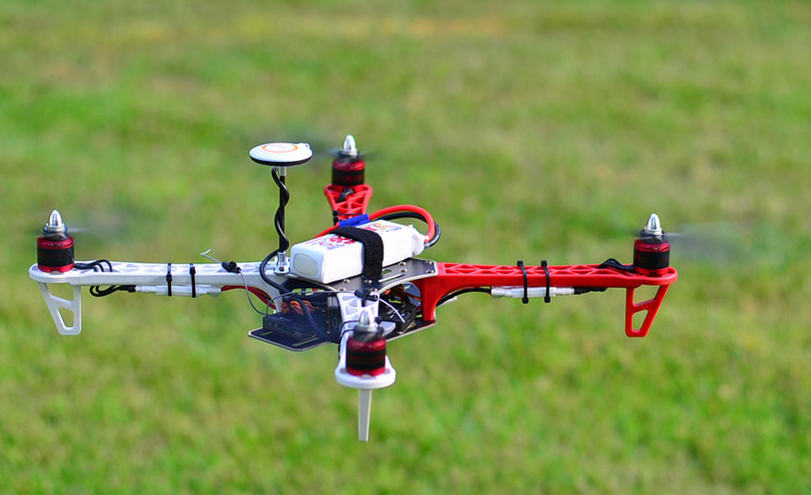
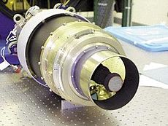
Why do we care?

Slide 4


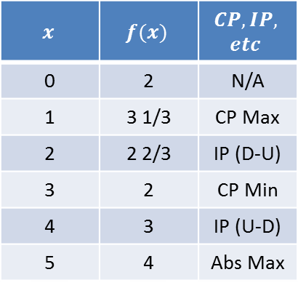


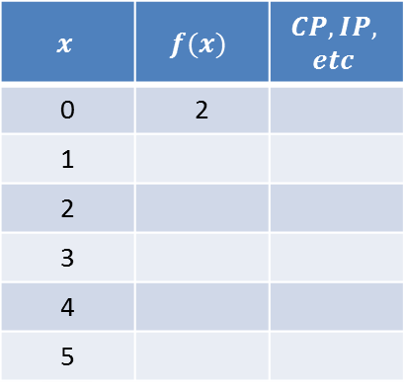


Graphing Antiderivatives
$$x$$ | $$f(x)$$ | $$CP,IP,$$ $$etc$$
0 | 2 | N/A
1 | 3 1/3 | CP Max
2 | 2 2/3 | IP (D-U)
3 | 2 | CP Min
4 | 3 | IP (U-D)
5 | 4 | Abs Max
$$x$$ | $$f(x)$$ | $$CP,IP,$$ $$etc$$
0 | 2
1
2
3
4
5
$$f′(x)$$
Area = 2
Area = 4/3
Area = 4/3
$$f(x)$$
$$( − )$$
$$( + )$$
$$( − )$$
$$f"(x)$$
Notes:
0
2
NA
1
$3\frac{1}{3}$
Max
2
$2\frac{2}{3}$
IP (DU)
3
2
Min
4
3
IP(UD)
5
4
Max

Slide 5












Derivatives
Rules | Properties
Constant | Constant Multiple
Power | Sum/Diff
Exponential | L’Hospital’s Rule
Product
Quotient
Trigonometric
Chain Rule
Logarithmic
$$\frac{d}{dx}\left(c\right)=0$$
$$\frac{d}{dx}[cf\left(x\right)]=c\frac{d}{dx}f(x)$$
$$\frac{d}{dx}\left(x^{n}\right)=nx^{n−1}$$
$$\frac{d}{dx}\left[f\left(x\right)±g\left(x\right)\right]=\frac{d}{dx}f\left(x\right)±\frac{d}{dx}g\left(x\right)$$
$$\frac{d}{dx}a^{x}={ln⁡(a)∙a}^{x}$$
$$\lim_{x→a}{\frac{f(x)}{g(x)}}=\lim_{x→a}{\frac{f′(x)}{g′(x)}}$$
$$\frac{d}{dx}\left[f\left(x\right)g\left(x\right)\right]=g\left(x\right)\frac{d}{dx}f\left(x\right)+f(x)\frac{d}{dx}g\left(x\right)$$
$$\frac{d}{dx}\left[\frac{f\left(x\right)}{g\left(x\right)}\right]=\frac{g\left(x\right)\frac{d}{dx}f\left(x\right)−f(x)\frac{d}{dx}g\left(x\right)}{{\left(g(x)\right)}^{2}}$$
$$\frac{d}{dx}\sin{x}=\cos{x}$$
$$\frac{d}{dx}\cos{x}=−sin{x}$$
$$\frac{d}{dx}\left[f\left(g\left(x\right)\right)\right]=f′\left(g\left(x\right)\right)∙\frac{d}{dx}g\left(x\right)$$
$$\frac{d}{dx}\left(\ln{x}\right)=\frac{1}{x}$$
Notes:
Mention L’Hopital’s Rule

Slide 6
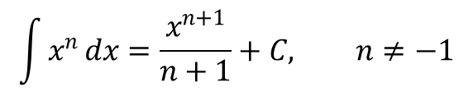
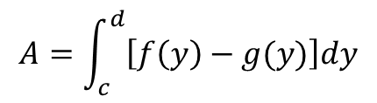
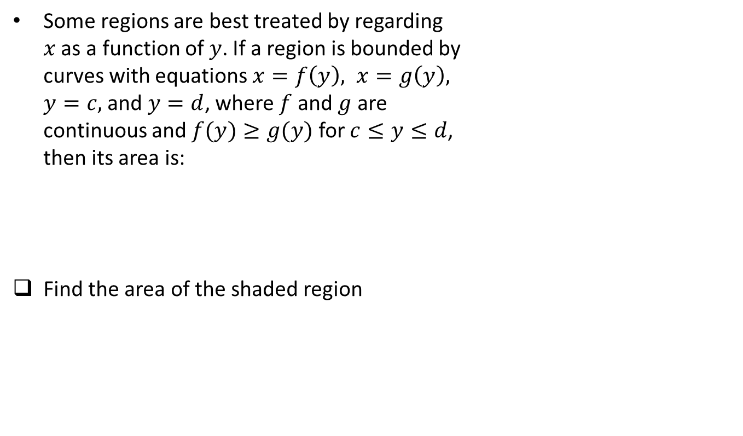
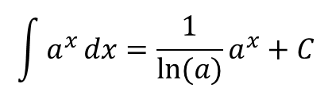
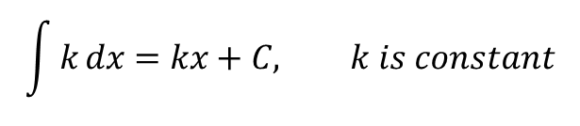
Common Antiderivatives
If $F^{′}\left(x\right)=f\left(x\right)$ then we say that $F$ is the antiderivative of $f$
$$\int{k}dx=kx+C, k is constant$$
$$\int{x^{n}}dx=\frac{x^{n+1}}{n+1}+C, n≠−1$$
$$\int{\frac{1}{x}}dx=\ln\left(\left|x\right|\right)+C$$
$$\int{a^{x}}dx={\frac{1}{\ln{(a)}}a}^{x}+C$$
$$\int{e^{x}}dx=e^{x}+C$$
$$\int{\cos\left(x\right)}dx=\sin\left(x\right)+C$$
$$\int{\sin\left(x\right)}dx=−\cos\left(x\right)+C$$
If $F\left(x\right)$ is an antiderivative, the most general form is $F\left(x\right)+C$
Notes:
Work problem 65: Stone dropped from CN Tower at 450m

Slide 7
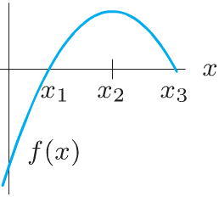
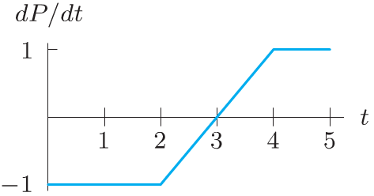
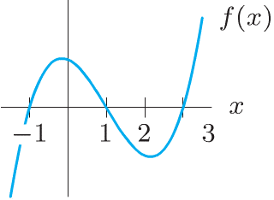
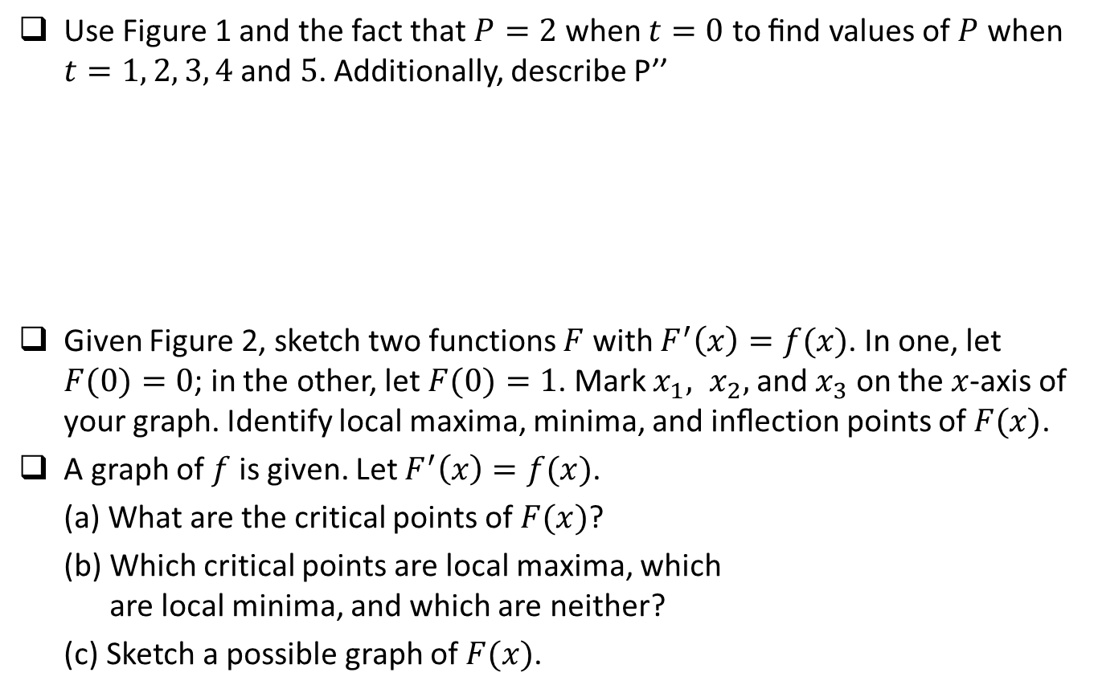
Board Work
Use Figure 1 and the fact that $P=2$ when $t=0$ to ﬁnd values of $P$ when $t=1, 2, 3, 4$ and $5$. Additionally, describe P’’
Given Figure 2, sketch two functions $F$ with $F^{′}\left(x\right)=f(x)$. In one, let $F(0)=0$; in the other, let $F(0)=1$. Mark $x_{1}, x_{2},$ and $x_{3}$ on the $x$-axis of your graph. Identify local maxima, minima, and inﬂection points of $F(x)$.
A graph of $f$ is given. Let $F^{′}\left(x\right)=f(x)$.
(a) What are the critical points of $F(x)$?
(b) Which critical points are local maxima, which are local minima, and which are neither?
(c) Sketch a possible graph of $F(x)$.
Figure 1
Figure 2

Slide 8

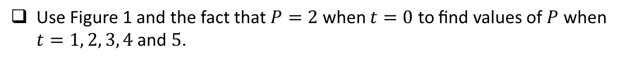







Board Work
Use Figure 1 and the fact that $P=2$ when $t=0$ to ﬁnd values of $P$ when $t=1, 2, 3, 4$ and $5$.
$$A=1.5$$
$$P′(t)$$
$$A=2.5$$
Figure 1
$$P(t)$$
$$P"(t)$$
$$( 0 )$$
$$( + )$$
$$(0)$$
Notes:
Notice, the slope (p’(t)) of p(t) is -1, then +1

Slide 9






Board Work
Given Figure 2, sketch two functions $F$ with $F^{′}\left(x\right)=f(x)$. In one, let $F(0)=0$; in the other, let $F(0)=1$. Mark $x_{1}, x_{2},$ and $x_{3}$ on the $x$-axis of your graph. Identify local maxima, minima, and inﬂection points of $F(x)$.
$$F′(x)$$
$$F(x)$$
$$F"(x)$$
$$( + )$$
$$( − )$$

Slide 10

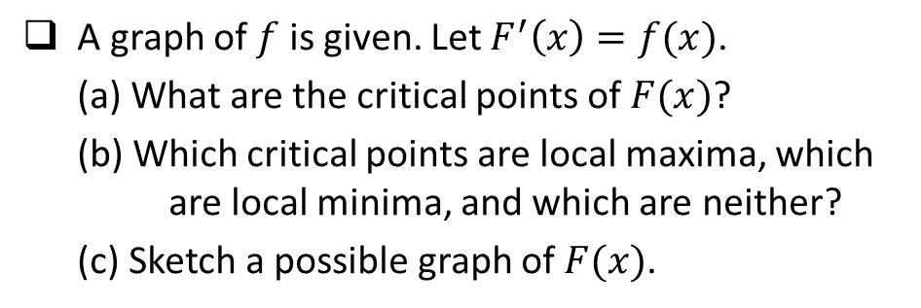





Board Work
A graph of $f$ is given. Let $F^{′}\left(x\right)=f(x)$.
(a) What are the critical points of $F(x)$?
(b) Which critical points are local maxima, which are local minima, and which are neither?
(c) Sketch a possible graph of $F(x)$.
$$F′(x)$$
$$F(x)$$
$$( + )$$
$$( − )$$
$$( + )$$
$$F"(x)$$

Slide 11
Backup

Slide 12
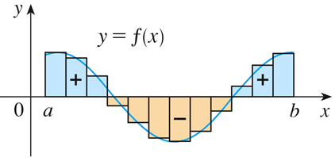
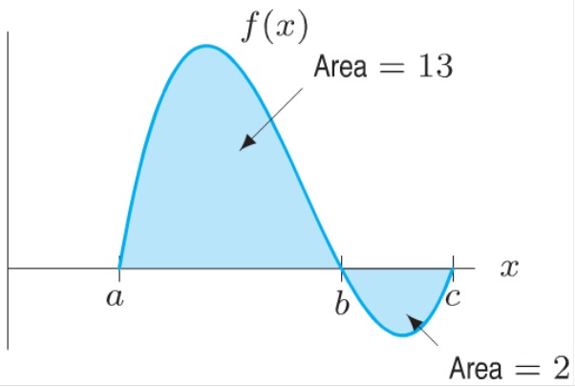
Definite Integral - Riemann Sums
If f takes on both positive and negative values, as in the Figure, then the Riemann sum is the sum of the areas of the rectangles that lie above the x-axis and the negatives of the areas of the rectangles that lie below the x-axis (the areas of the blue rectangles minus the areas of the gold rectangles).
A definite integral can be interpreted as a net area, that is, a difference of areas.
Example: Use the figure to find the values of:
(a) $\int_{a}^{b}{f\left(x\right)dx}$ (b) $\int_{b}^{c}{f\left(x\right)dx}$
(c) $\int_{a}^{c}{f\left(x\right)dx}$ (d) $\int_{a}^{c}{\left|f\left(x\right)dx\right|}$
Notes:
a) 13 b) -2 c)11 d)15
When we take the limit of such Riemann sums, we get the situation illustrated.
A definite integral can be interpreted as a net area, that is, a difference of areas where A₁ is the area of the region above the x-axis and below the graph of f, and A₂ is the area of the region below the x-axis and above the graph of f.

